Slide 1


REAL MADRID ANALYTICS
UEFA CHAMPIONS LEAGUE 2021/2022
CHAMPIONS LEAGUE
WINNER
By: Dicky Alvion Abrar

Slide 2

UEFA CHAMPIONS LEAGUE WINNER 2021/2022
Real Madrid is the winner of
UEFA CHAMPIONS LEAGUE 2021/2022
This analysis aims to understand how Real Madrid won the title for the 14th time.

Slide 3
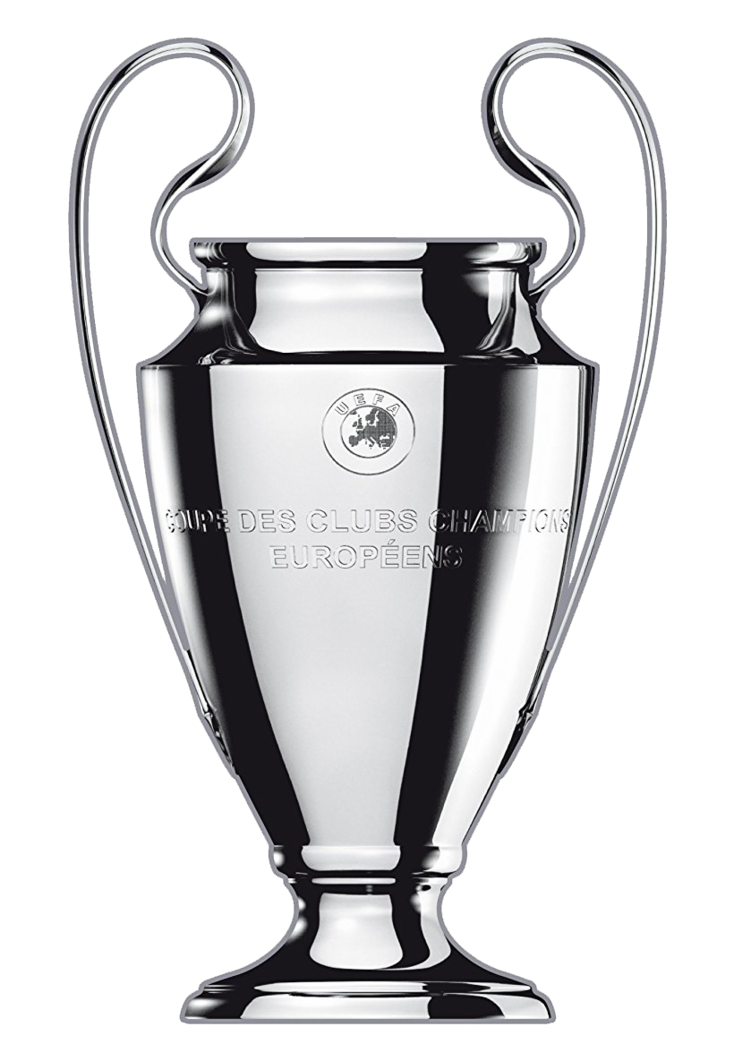
REAL MADRID ANALYTICS
UEFA CHAMPIONS LEAGUE 2021/2022
Purpose of Analysis:
Identify the factors that contributed to Real Madrid's success in the UEFA Champions League 2021/2022.
Provide insights that can be useful for football fans, especially Madridistas.

Slide 4



REAL MADRID ANALYTICS
UEFA CHAMPIONS LEAGUE 2021/2022
Data Sources:
This data comes from the Kaggle Dataset website. Here is the link to the dataset used:
https://www.kaggle.com/datasets/azminetoushikwasi/ucl-202122-uefa-champions-league?select=goals.csv
Tools:
Cleaning Data
Dashboard Visualization

Slide 5

REAL MADRID ANALYTICS
UEFA CHAMPIONS LEAGUE 2021/2022
Data Cleaning:
Change the data type
Change NULL data
Remove duplicate
Joining table

Slide 6
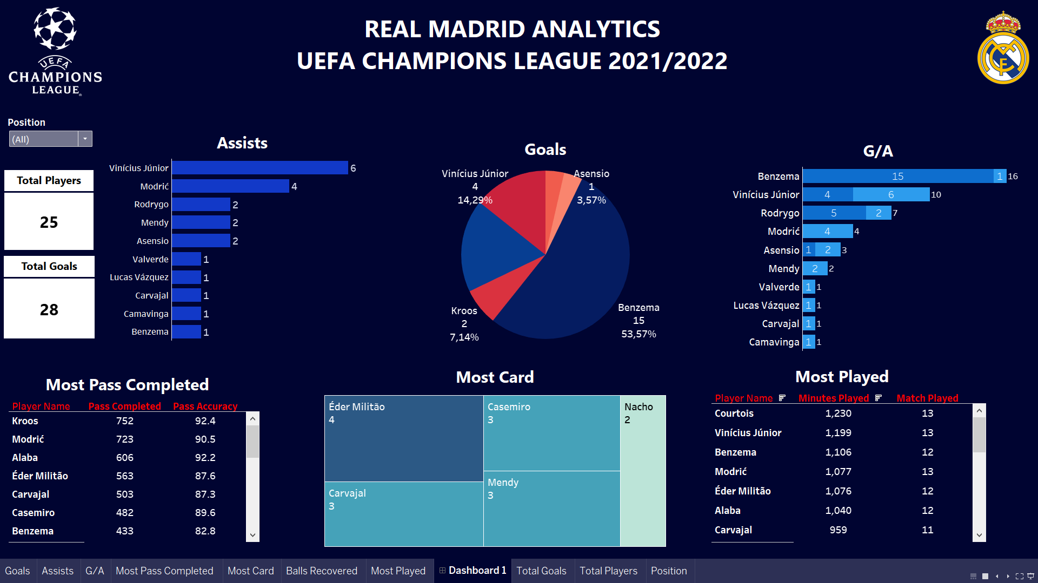
ANALYSIS
Total Players
Total Goals
A total of 25 players were registered by Real Madrid to participate in this competition
A total of 28 goals were scored by all players

Slide 7
ANALYSIS
Players Goals
Player Assists
Benzema is the team's top scorer with a total of 15 goals or 53.57% goal contributions.
Vinicius and Modric are the players who have made the most assists for the team.

Slide 8
ANALYSIS
Players G/A
Benzema and Vinicius became the players who contributed the most to Real Madrid up front with a total of 16 and 10 goals/assists contributions.

Slide 9
ANALYSIS
Most Played
Courtois became the player who played the most, namely for 13 matches with 1230 minutes played. This means Courtois participated in all the matches played.
Other players who also participated in the entire match were Vinicius and Modric.
Benzema despite missing 1 match, he still has more minutes than Modric.

Slide 10
ANALYSIS
Pass Completed
Kroos became the player who completed the most passes with 752 successful passes and 92.4% accurate passes.
Modric became the second player under Kroos in passing matters
This means that Real Madrid's game is controlled by Kroos and Modric.

Slide 11
ANALYSIS
Player with Most Yellow Card
Eder Militao is the player who has received the most yellow cards with 4 yellow cards.
Then followed by Casemiro, Carvajal, and Mendy with 3 yellow cards.
None of Real Madrid's players received red cards during the competition.

Slide 12
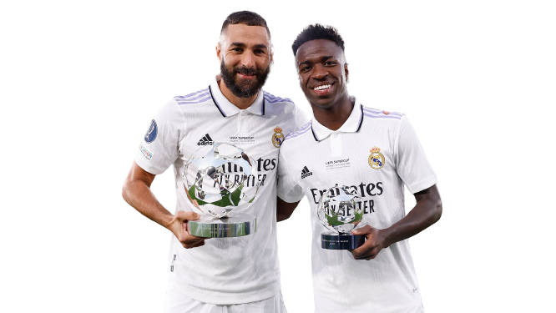
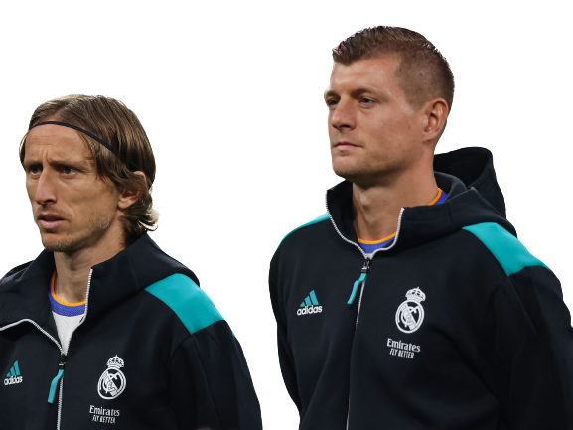
CONCLUSION
Real Madrid won the UEFA Champions League 2021/2022 title thanks to a combination of the following factors:
The attack was prolific, with Vinicius and Benzema as key players up front.
A dominant passing game, with Kroos and Modric as key players and backline links to the front line.

Slide 13
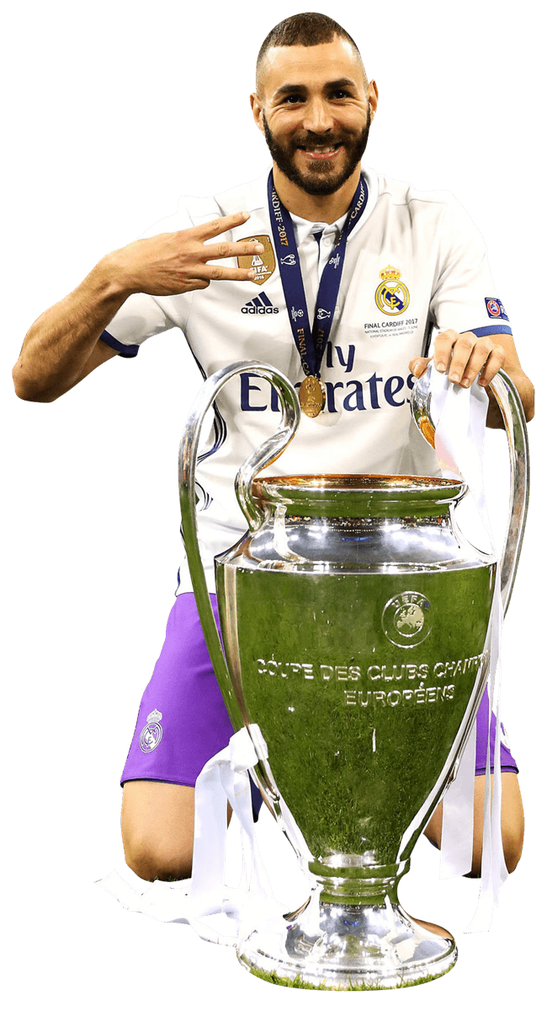
SUGGESTION
The goal difference between Benzema and other players is very far. This means that Real Madrid's goals depend heavily on Benzema.
The new season is underway and Real Madrid have lost Benzema to the Arab League. Real Madrid need to find another striker who has a keen goal instinct like Benzema.
Because “If you concede 2 goals, but you score 3 goals. You still won the game.”

Slide 14
DASHBOARD

Slide 15



MORE INFORMATIONS
Data and Queries:
https://github.com/dickyalvion/real-madrid-ucl-2022
Dashboard:
https://public.tableau.com/views/RealMadridUCLAnalytics/Dashboard1?:language=en-US&:display_count=n&:origin=viz_share_link
You can find me at
http://www.linkedin.com/in/dicky-alvion-a53215245
dickyabrar11@gmail.com
https://github.com/dickyalvion

Slide 16

MORE INFORMATIONS
Do you want to see which queries I'm using?
If you're interested in seeing the SQL queries I use to clean up data and perform simple analysis in SQL, you can swipe over to the next slide. The next slide is my documentation when cleaning data using Microsoft Server SQL.
NEXT SLIDE

Slide 17
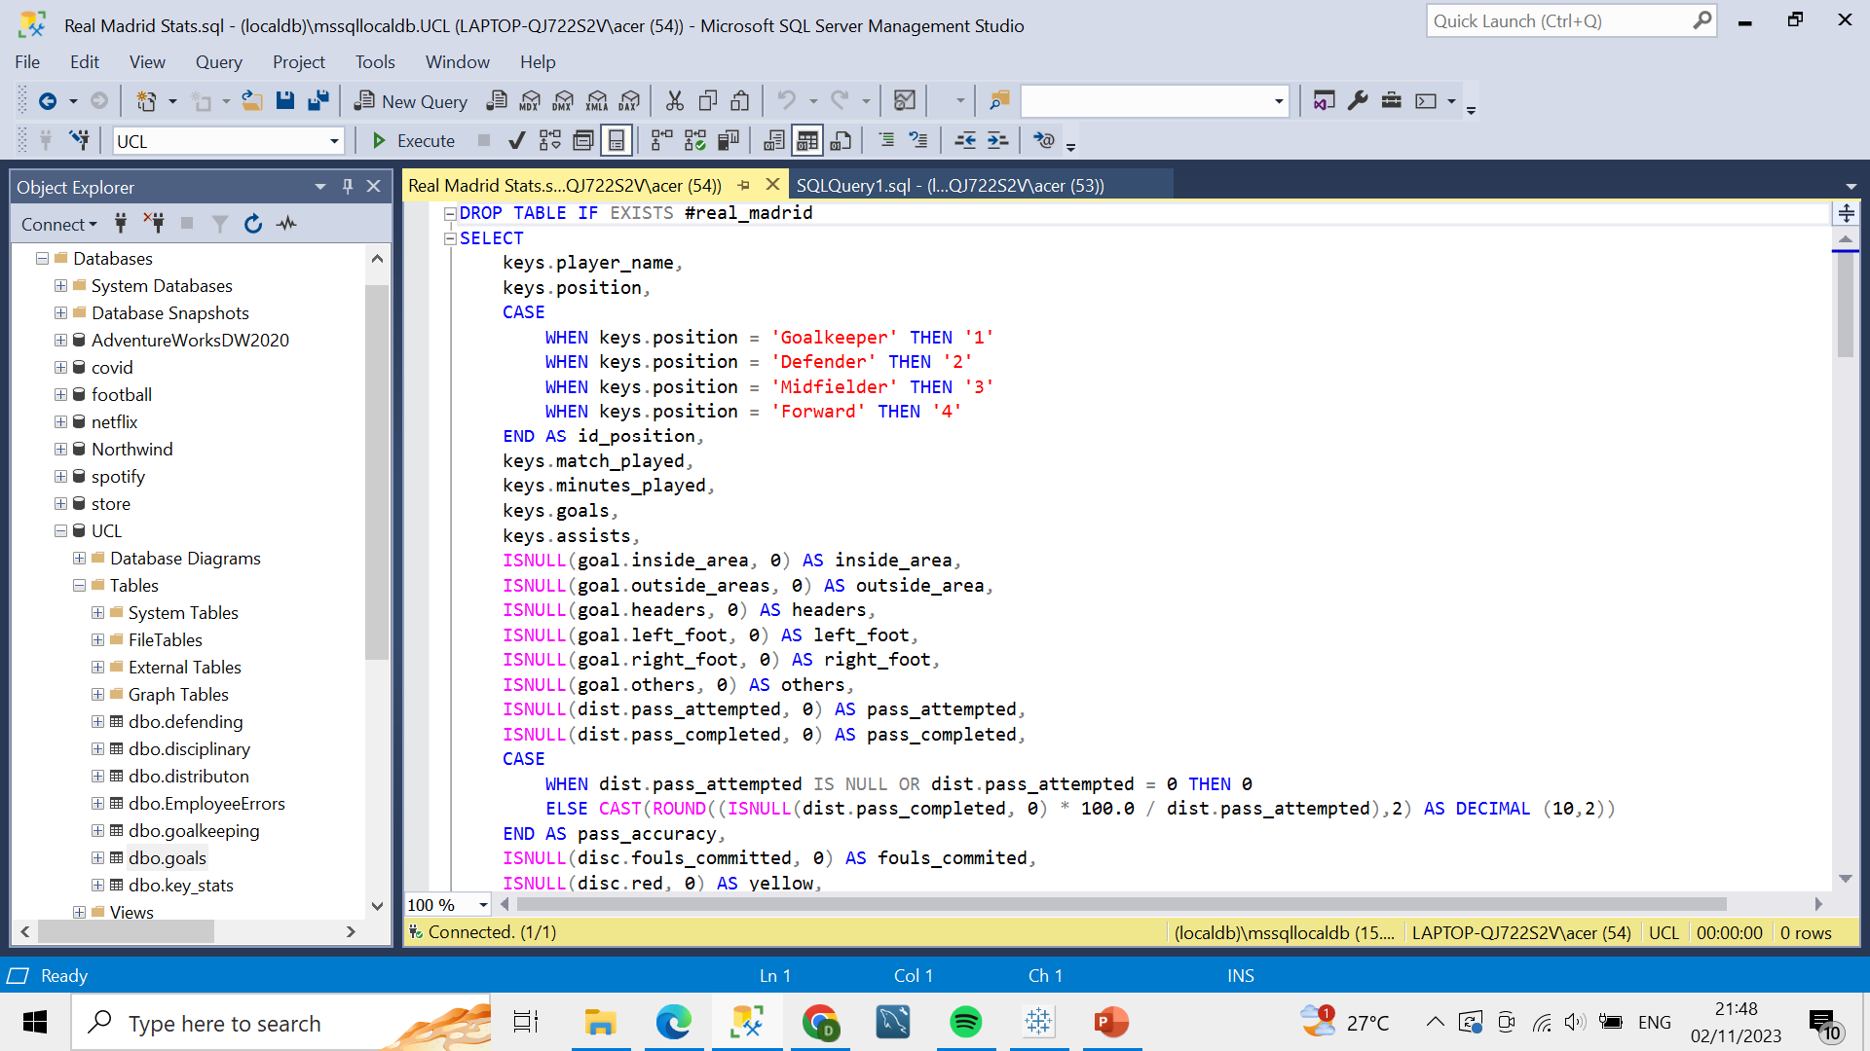
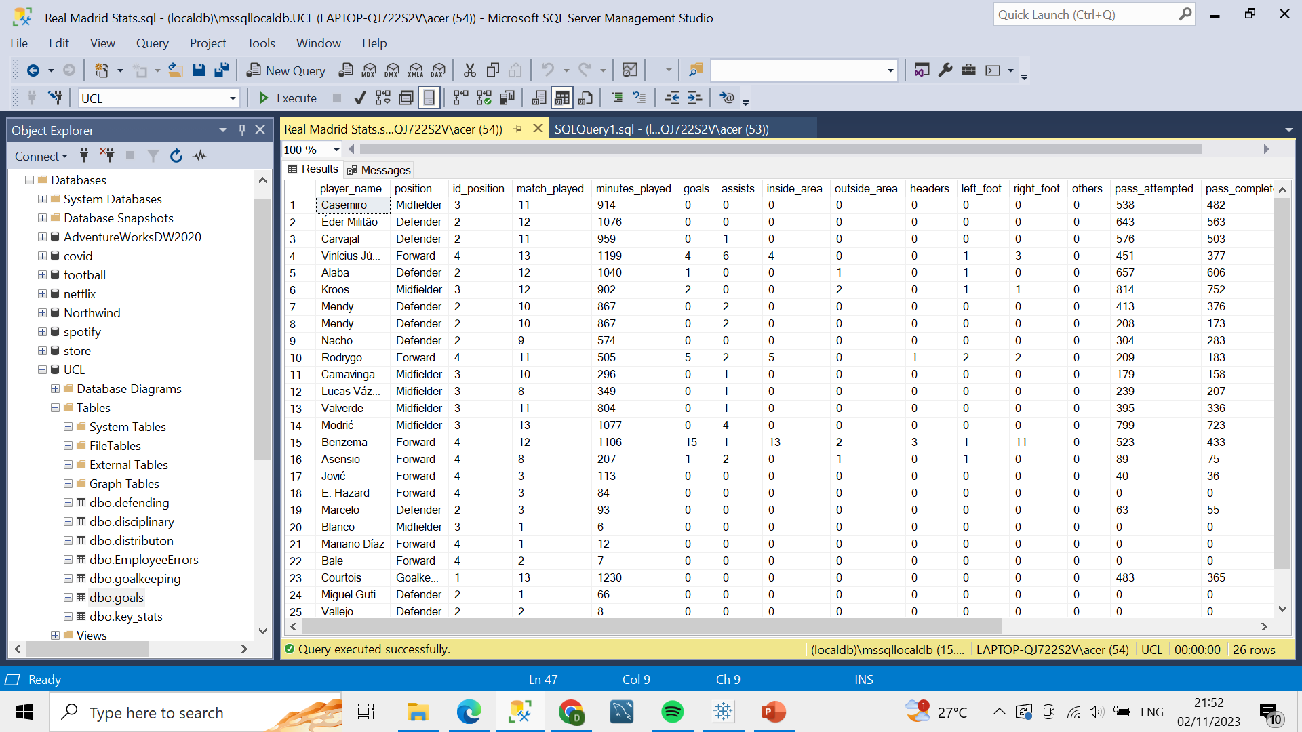
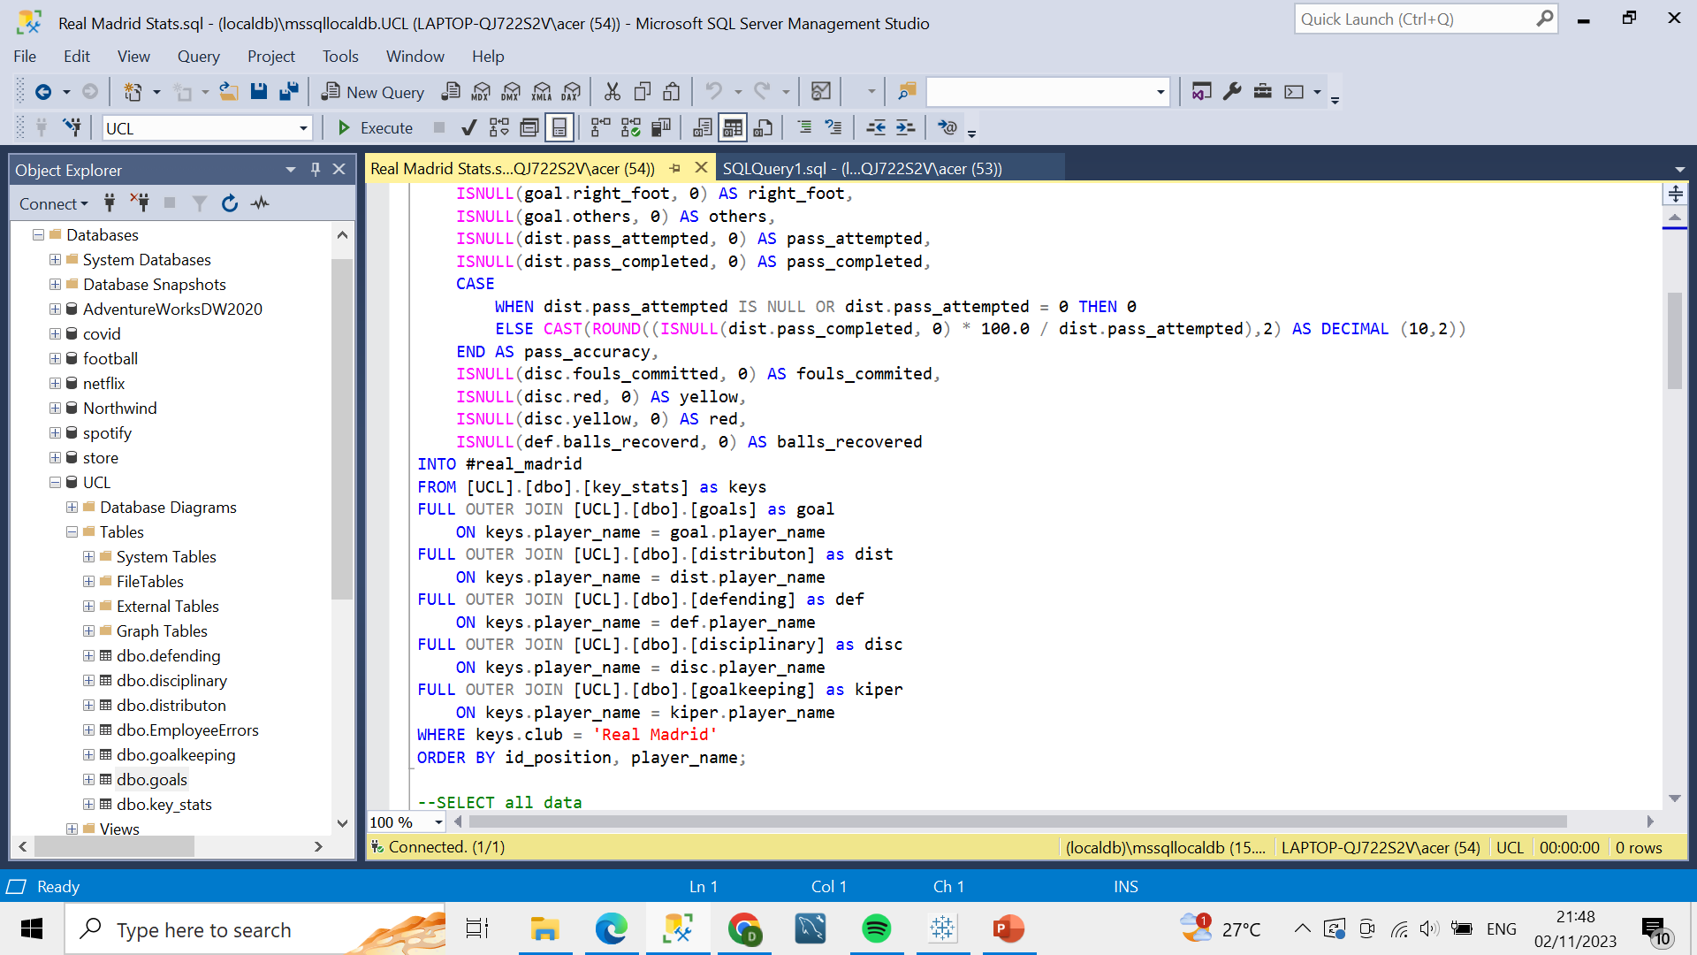
SQL QUERIES
Joining Table
Result

Slide 18
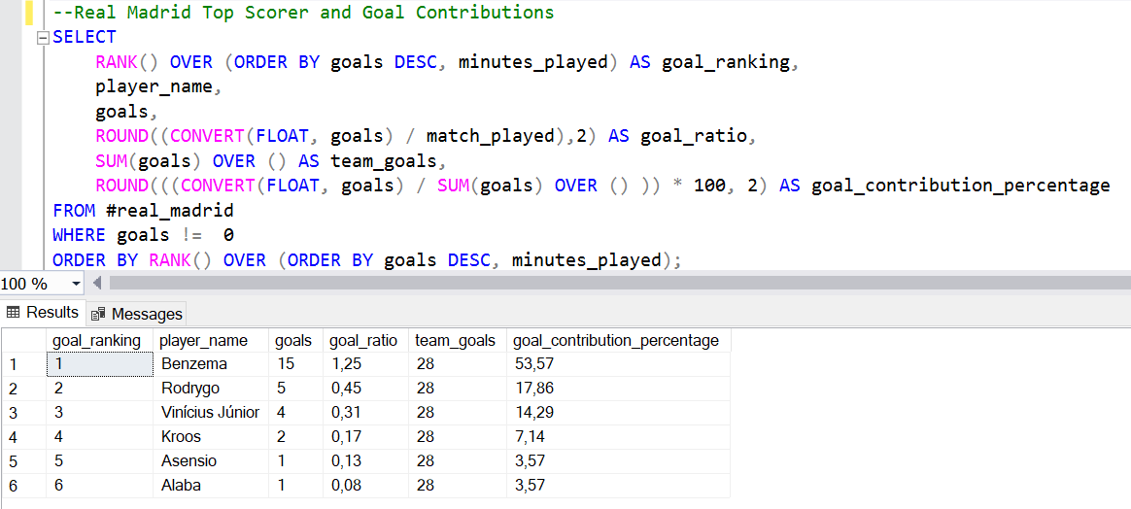
SQL QUERIES
Queries
Result

Slide 19
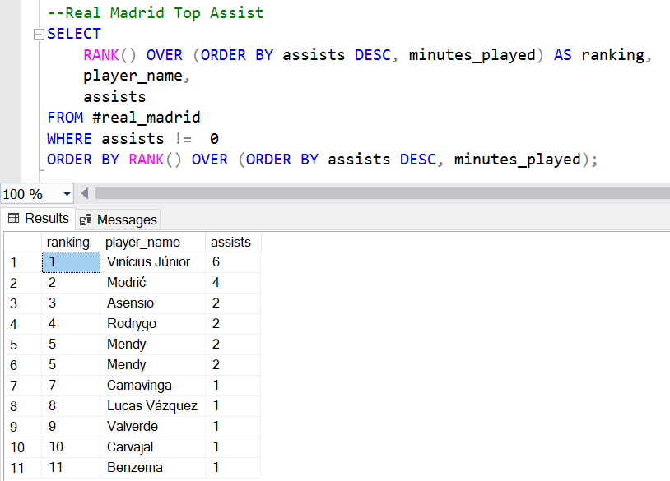
SQL QUERIES
Queries
Result

Slide 20
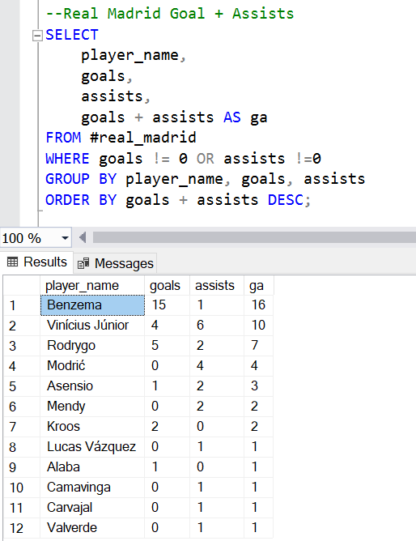
SQL QUERIES
Queries
Result

Slide 21
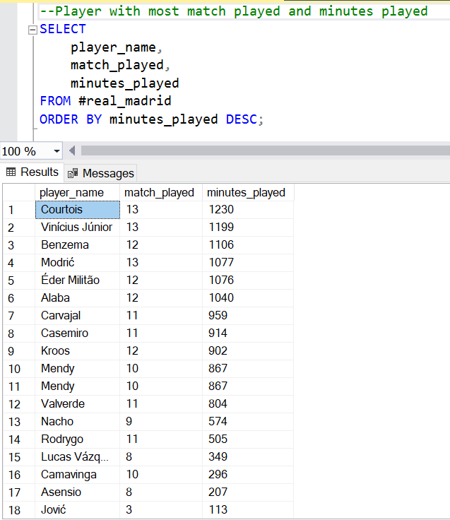
SQL QUERIES
Queries
Result

Slide 22
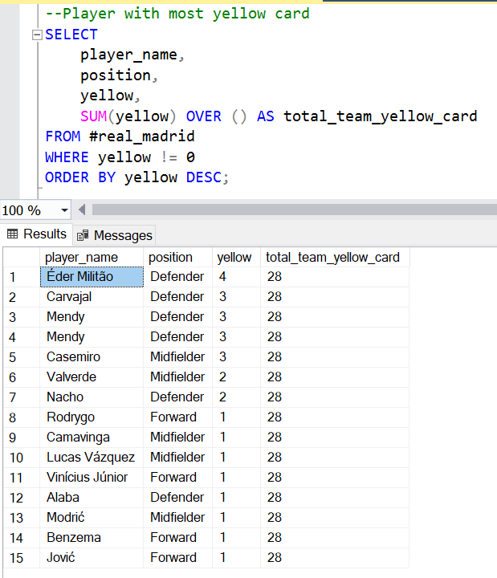
SQL QUERIES
Queries
Result

Slide 23
THANKS

